Slide 1
NEO4J CYPHER TUTORIAL WITH PYTHON
Uses of exists clasue
Tutorial 71

Slide 2
Exists clause
Definition
exists() returns true if a match for the given pattern exists in the graph, or if the specified property
exists in the node, relationship or map. null is returned if the input argument is null.

Slide 3
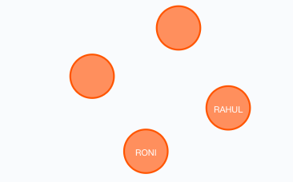
Exists clause use case
Sample graph

Slide 4
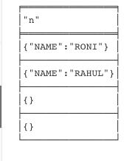
Exists clause use case
Sample graph

Slide 5
Find the nodes where NAME property is present using exists clause(from neo4j web ui)
Cypher query
MATCH (N)
WHERE exists(N.NAME)
RETURN N

Slide 6
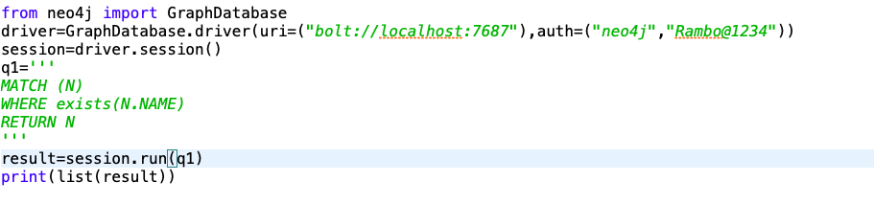
Find the nodes where NAME property is present using exists clause(from python ide)
Cypher query from python ide

